Slide 1
Spring MVC
Spring MVC

Slide 2
Spring MVC
Spring MVC provides an elegant solution to use MVC in spring framework by the help of DispatcherServlet.
In Spring Web MVC, DispatcherServlet class works as the front controller. It is responsible to manage the flow of the spring mvc application.
The @Controller annotation is used to mark the class as the controller in from Spring 3.
The @RequestMapping annotation is used to map the request URL. It is applied on the method.

Slide 3
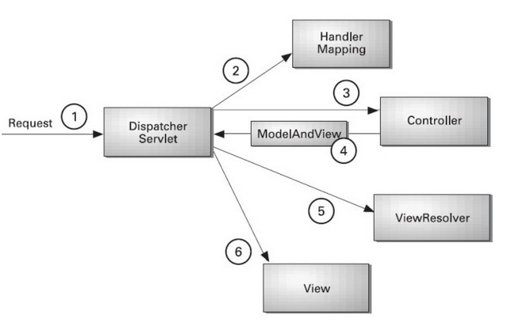
***Spring Web MVC - Architecture

Slide 4
Explanation
All the incoming request is intercepted by the DispatcherServlet that works as the front controller.
The DispatcherServlet gets entry of handler mapping from the xml file and forwards the request to the controller.
The controller returns an object of ModelAndView.
The DispatcherServlet checks the entry of view resolver in the xml file and invokes the specified view component.

Slide 5
Spring MVC Example

Slide 6
8 steps for creating the spring MVC application
Create Dynamic web project
Load the spring core and mvc jar files
Create the request page (optional)
Create the controller class
Provide the entry of controller in the web.xml file
Define the bean in the xml file
Display the message in the JSP page
Start server and deploy the project

Slide 7
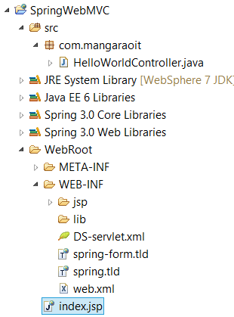
Directory Structure

Slide 8
Required Jar files or Maven Dependency
To run this example, you need to load:
Spring Core jar files
Spring Web jar files
If you are using Maven, you don't need to add jar files. Now, you need to add spring maven dependency in pom.xml file.
Note: You make sure to add same (above) libraries in lib folder to make them available at runtime

Slide 9
pom.xml
<dependency>
<groupId>javax.servlet</groupId>
<artifactId>servlet-api</artifactId>
<version>3.0-alpha-1</version>
</dependency>
<dependency>
<groupId>org.springframework</groupId>
<artifactId>spring-core</artifactId>
<version>3.1.2.RELEASE</version>
</dependency>
<dependency>
<groupId>org.springframework</groupId>
<artifactId>spring-context</artifactId>
<version>3.1.2.RELEASE</version>
</dependency>
<dependency>
<groupId>org.springframework</groupId>
<artifactId>spring-beans</artifactId>
<version>3.1.2.RELEASE</version>
</dependency>
<dependency>
<groupId>org.springframework</groupId>
<artifactId>spring-webmvc</artifactId>
<version>3.1.2.RELEASE</version>
</dependency>

Slide 10
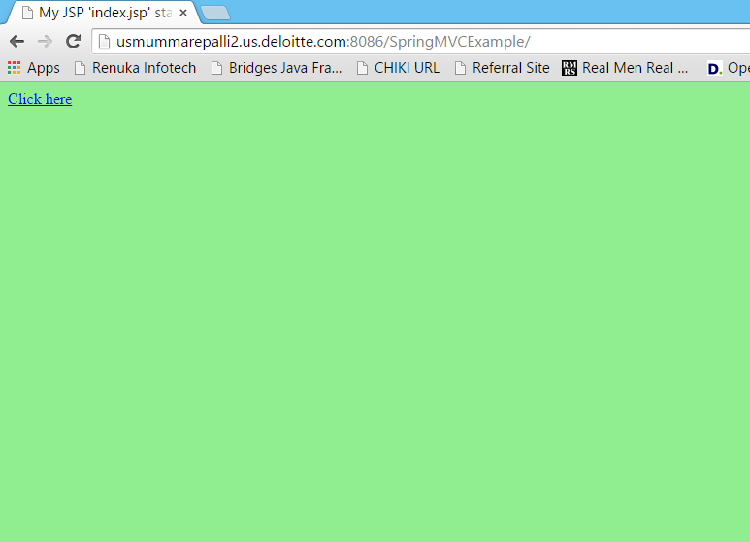
Request Screen

Slide 11
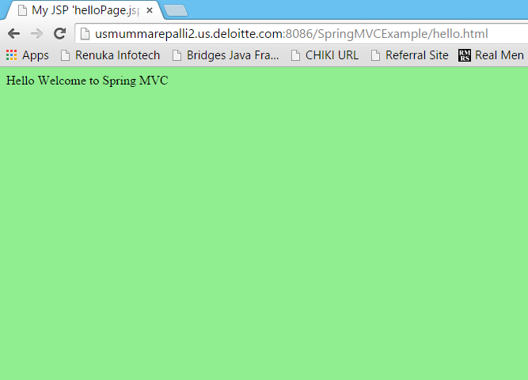
Output Screen

Slide 12
1) Create the request page (optional)
This is the simple jsp page containing a link. It is optional page. You may direct invoke the action class instead.

Slide 13
index.jsp
<a href="hello.html">click</a>

Slide 14
2) Create the controller class
To create the controller class, we are using two annotations @Controller and @RequestMapping.
The @Controller annotation marks this class as Controller.
The @Requestmapping annotation is used to map the class with the specified name.
This class returns the instance of ModelAndView controller with the mapped name, message name and message value. The message value will be displayed in the jsp page.

Slide 15
HelloWorldController.java
package com.myit;
import org.springframework.stereotype.Controller;
import org.springframework.web.bind.annotation.RequestMapping;
import org.springframework.web.servlet.ModelAndView;
@Controller
public class HelloWorldController {
@RequestMapping("/hello")
public ModelAndView helloWorld() {
String message = "HELLO SPRING MVC HOW R U";
return new ModelAndView("hellopage", "message", message);
}
}

Slide 16
3) Provide the entry of controller in the web.xml file
In this xml file, we are specifying the servlet class DispatcherServlet that acts as the front controller in Spring Web MVC.
All the incoming request for the html file will be forwarded to the DispatcherServlet.

Slide 17
web.xml
<web-app>
<servlet>
<servlet-name>spring</servlet-name>
<servlet-class>org.springframework.web.servlet.DispatcherServlet</servlet-class>
<load-on-startup>1</load-on-startup>
</servlet>
<servlet-mapping>
<servlet-name>spring</servlet-name>
<url-pattern>*.html</url-pattern>
</servlet-mapping>
</web-app>

Slide 18
4) Define the bean in the xml file
This is the important configuration file where we need to specify the ViewResolver and View components.
The context:component-scan element defines the base-package where DispatcherServlet will search the controller class.
Here, the InternalResourceViewResolver class is used for the ViewResolver.
The prefix+string returned by controller+suffix page will be invoked for the view component.
This xml file should be located inside the WEB-INF directory.

Slide 19
spring-servlet.xml
<?xml version="1.0" encoding="UTF-8"?>
<beans xmlns="http://www.springframework.org/schema/beans"
xmlns:xsi="http://www.w3.org/2001/XMLSchema-instance"
xmlns:p="http://www.springframework.org/schema/p"
xmlns:context="http://www.springframework.org/schema/context"
xsi:schemaLocation="http://www.springframework.org/schema/beans
http://www.springframework.org/schema/beans/spring-beans-3.0.xsd
http://www.springframework.org/schema/context
http://www.springframework.org/schema/context/spring-context-3.0.xsd">
<context:component-scan base-package="com.myit" />
<bean class="org.springframework.web.servlet.view.InternalResourceViewResolver">
<property name="prefix" value="/WEB-INF/jsp/" />
<property name="suffix" value=".jsp" />
</bean>
</beans>

Slide 20
5) Display the message in the JSP page
This is the simple JSP page, displaying the message returned by the Controller.
It must be located inside the WEB-INF/jsp directory for this example only.

Slide 21
hellopage.jsp
${message}

Slide 22
Spring 3 MVC Multiple Controller Example
Multi Controller Example

Slide 23
Spring 3 MVC Multiple Controller Example
We can have a lot of controller classes in Spring Framework. In this example, we are creating two Controller classes
1. HelloWorldController
2. WelcomeWorldController.

Slide 24
1) Controller Classes

Slide 25
HelloWorldController.java
@Controller
public class HelloWorldController {
@RequestMapping("/hello")
public ModelAndView helloWorld() {
String message = "HELLO SPRING MVC";
return new ModelAndView("hellopage", "message", message);
}
}

Slide 26
WelcomeWorldController.java
@Controller
public class WelcomeWorldController {
@RequestMapping("/welcome")
public ModelAndView helloWorld() {
String message = "WELCOME SPRING MVC";
return new ModelAndView("welcomepage", "message", message);
}
}

Slide 27
2) View components

Slide 28
helloPage.jsp
Message is: ${message}

Slide 29
welcomePage.jsp
Message is: ${message}

Slide 30
Spring MVC Request Response Example
We can simply create login application by following the Spring MVC. We need to pass HttpServletRequest and HttpServletResponse objects in the request processing method of the Controller class. Let's see the example:

Slide 31
Spring MVC Login Example

Slide 32
Login Example
We need to pass HttpServletRequest and HttpServletResponse objects in the request processing method of the Controller class.

Slide 33
1) Controller Class

Slide 34
LoginController.java
@Controller
public class LoginController {
@RequestMapping("/hello")
public ModelAndView helloWorld(HttpServletRequest request,HttpServletResponse res) {
String name=request.getParameter("name");
String password=request.getParameter("password");
if(password.equals("admin")){
String message = "HELLO "+name;
return new ModelAndView("hellopage", "message", message);
}
else{
return new ModelAndView("errorpage", "message","Sorry, username or password error");
}
}
}

Slide 35
2) View components

Slide 36
hellpPage.jsp
${message}

Slide 37
errorPage.jsp
${message}
<jsp:include page="/index.jsp"></jsp:include>

Slide 38
3) Index page
<form action="hello.html" method="post">
Name:<input type="text" name="name"/><br/>
Password:<input type="password" name="password"/><br/>
<input type="submit" value="login"/>
</form>

Slide 39
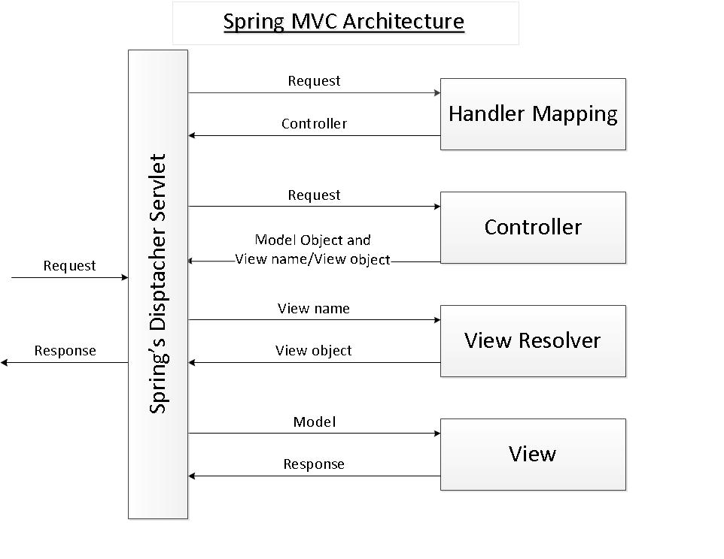
A brief overview about Spring MVC

Slide 40
As its name says, the Spring MVC framework is based on the Model - View - Controller (MVC) design pattern which separates the application’s logic into the three layers Mode, View and Controller. MVC is implemented in Spring by the following components:
Spring’s dispatcher servlet: acts as a front controller between the Spring application and its clients. The dispatcher servlet intercepts all requests coming to the application and consults the Handler Mapping for which controller to be invoked to handle the requests.
Handler Mapping: is responsible to find appropriate controllers that handle specific requests. The mapping between request URLs and controller classes is done via XML configuration or annotations.
Controller: is responsible to process the requests by calling other business/service classes. The output can be attached to model objects which will be sent to the view. To know which view will be rendered, the controller consults the View Resolver.
View Resolver: finds the physical view files from the logical names.
View: physical view files which can be JSP, HTML, XML, Velocity template, etc.

Slide 41
Spring MVC Interview Questions

Slide 42
What is the front controller class of Spring MVC?
The DispatcherServlet class works as the front controller in Spring MVC.

Slide 43
What does @Controller annotatio
The @Controller annotation marks the class as controller class. It is applied on the class.

Slide 44
What does @RequestMapping annotation?
The @RequestMapping annotation maps the request with the method. It is applied on the method.

Slide 45
What does the ViewResolver class?
The View Resolver class resolves the view component to be invoked for the request. It defines prefix and suffix properties to resolve the view component.

Slide 46
Which ViewResolver class is widely used?
The org.springframework.web.servlet.view.InternalResourceViewResolver class is widely used.

Slide 47
Does spring MVC provide validation support?
Yes

Slide 48
Etc…

